Slide 1


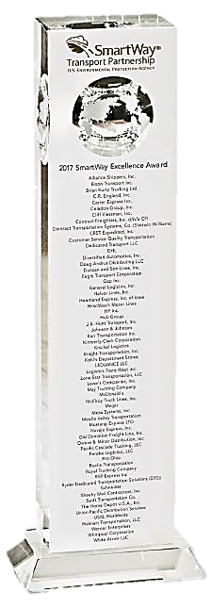

















Capability Statement
Corporate Overview
Areas of Expertise
For 20 years, Knichel Logistics has transported goods for America’s largest corporations. Specializing in intermodal, less than truckload, cross-country, and cross-border services, we have moved more than 200,000 containers with 385,000 trucks spanning over 295 million miles over the last 5 years alone. With access to 90,000 rail containers, we work with Sam’s Club, Costco, Johnson & Johnson, Ocean Spray, Samsung, and Staples to name a few.
Knichel also supports the federal government with recent logistical contracts for the Federal Emergency Management Agency (FEMA) and the Army and Air Force Exchange Service (AAFES). We successfully and seamlessly navigated the complexities of transporting 300 over-dimensional FEMA units for the Paradise, CA rebuild efforts.
In addition to our transportation services, we also specialize in Container Pool Management, which we currently provide to companies including Michelin, Meijer, Samsung and Johnson & Johnson. Ensuring ample equipment capacity for our customers is a crucial need that Knichel Logistics provides.
Knichel moves the sugar, milk, televisions, paper goods, health products, and foodstuff used by more than 300 million Americans. Our senior leadership possesses Lean Six Sigma certification and a seat on the TIA Board of Directors.
Intermodal Rail
Full Truckload/LTL
Warehousing
Expedited Shipping
Transloading/Cross Docking
Specialty Moves & Projects
Volume LTL & Partials
Cross Border Services
Mode Optimization
Container Pool Management
Performance Award
The Annual SmartWay® Excellence Award is awarded to providers who are industry leaders in freight supply chain environmental performance and energy efficiency.
Company Data
Past Performance – Partial List
UEI # ZWNBVR7SSL CAGE: 76XJ1
DOT #: 2230504 MC #: 454402
Status: WBE, WOSB
NAICS/PSC Codes:
482111 484220 488999
484110 484230 532411
484121 488210 V112 – Motor Freight
484122 488510 V113 – Rail Freight
Acquisition Options
Micro Purchase
Simplified Acquisition Procedures (SAP)
Blanket Purchase Agreement (BPA)
BPA with WOSB
WOSB Set Aside
Ashley Caloia
Government Contracting Officer
Ph: (724) 939-1048
acaloia@knichellogistics.com
Knichel Logistics
3000 Westinghouse Drive, Suite 401
Cranberry Township, PA 16066
724-449-3300 (main) 724-939-1065 (fax)

